Slide 1
Data Engineering
Kester (P1922897)
Kelyn (P1935800)
Jason (P1837902)
Alwin (P1935996)

Slide 2
Contents:
OLTP Table Design(8)
OLTP 2 Creation Scripts(Process)
OLTP Table creation
OLTP Insertion Creation
OLAP Design choice
OLAP Table Design (6)
OLAP 3 Creation Scripts(Process)
OLAP Table Creation
OLAP Time Dimension Insert
ETL Script
Data Accuracy

Slide 3
Things to note:
Columns with NOT NULL are essential data that cannot be null.
Columns with NULL are data that are optional.
Primary Keys uniquely identify each row in a table.
Foreign Keys reference Primary Keys.
Double, BLOB from MySQL are converted to FLOAT, IMAGE in MS SQL Server as double is not supported in MS SQL Server.

Slide 4
OLTP
Online Transactional Processing Database
Design

Slide 5
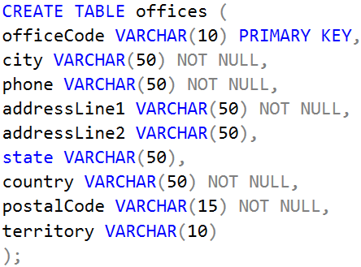
Design for OLTP Database: Offices
Purpose of this table
Houses the data regarding the current 7 different offices and the general information like the location of the offices.
Explanation of table fields
The officeCode is a primary key
Cannot be null and it uniquely identifies a row.
Referenced to by other tables (Foreign Key)
postalCode is not an integer,
Certain countries have alphanumeric postal code or special characters (‘-’) in their postalCode.
These values will then throw errors as they cannot be inserted into numeric data type columns.
Numeric calculations cannot be done on it as it is a varchar.

Slide 6
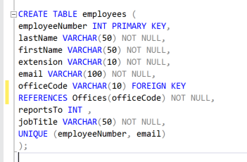
Design for OLTP Database: Employees
Purpose of this table
Contain the general information of all the registered employees, who they report to and which office they are assigned to, defined by the office code within the office table.
Explanation of table fields
ReportsTo is null as the President of the company does not report to anyone.
EmployeeNumber and Email are set as unique together as different employee numbers can share the same email.
As for office code, it is a foreign key referencing the office code from the Offices table.

Slide 7
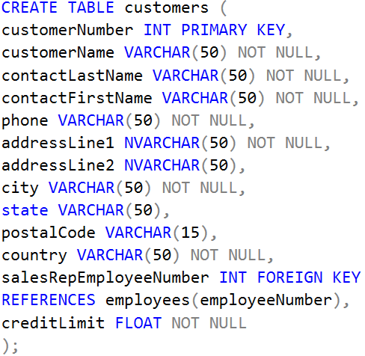
Design for OLTP Database: Customers
Purpose of this table
This table contains the general information about the customer, their shipping address, their assigned sales rep and their credit limit.
Explanation of table fields
CustomerNumber is the Primary Key for this table.
Even though salesRepEmployeeNumber is a Foreign Key referencing employeeNumber from the employees table, it can be NULL as new customers are not assigned employees from the get go.

Slide 8
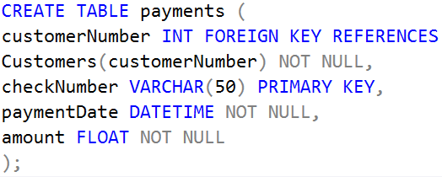
Design for OLTP Database: Payments
Purpose of this table
Contains the data of the payments made by customers.
It is used to keep track of Payments.
It allows the company to verify whether Payment has been made, when it was made and make necessary refund(s) if need be.
Explanation of table fields
The table contains checkNumber which is the Primary Key.
There is the CustomerNumber which is a Foreign Key referencing the Customers tables’ PK ‘customerNumber’.
Without this reference, we wouldn’t be able to derive the customer who made the Payment.
Able to output expenditure of the customer to be verified by their Credit Limit.

Slide 9
Design for OLTP Database: Payments
Explanation of table fields
PaymentDate identifies when the payment was made.
However, no other information can be identified as there is no other link to the other tables.
Plus payment dates vary, where it can be before or after -> Order Date -> Required Date -> Shipped Date
The amount helps to verify the total paid and refunds amounts if needed.

Slide 10
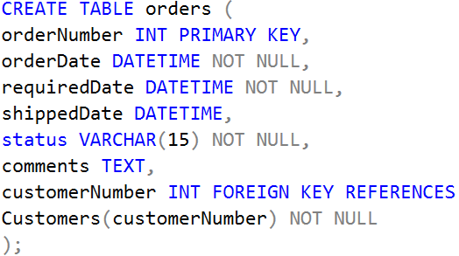
Design for OLTP Database: Orders
Purpose of this table
Stores all information regarding orders made by customers identified by their unique order numbers.
Explanation of table fields
The table contains the primary key orderNumber.
orderDate and requiredDate are essential thus they are not null. However, for shippedDate, it can be NULL as an order can be on hold and the shippedDate has not been decided yet.
DATETIME datatype to suit a date format. Comments are also NULL.

Slide 11
Design for OLTP Database: Orders
Explanation of table fields
The status attribute cannot be null as every order must have a status stating that it’s completed or cancelled or in process.
And lastly for this table, we have the customer number, which is a foreign key referencing the PK ‘CustomerNumber’ in the customers table.

Slide 12
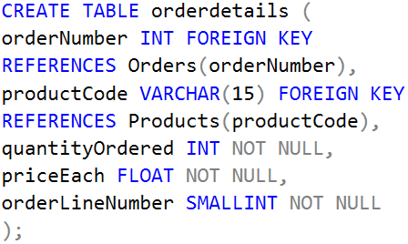
Design for OLTP Database: Orderdetails
Purpose of this table
Stores all order information of different products associated with a particular order number.
Explanation of table fields
Orderdetails does not have a primary key as it is an extension of orders.
OrderNumber is a foreign key that references the order table, orderNumber column.
The productCode is also a foreign key that references the product table, productCode column.
The orderLineNumber determines which position the order is in within a day

Slide 13
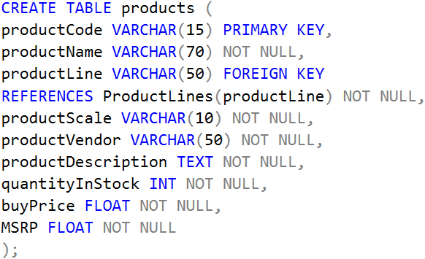
Design for OLTP Database: Products
Purpose of this table
The purpose of this table is to contain the details of the individual products classified by their unique product code.
Explanation of table fields
productCode is the Primary Key that uniquely identifies each row in the table.
productLine FK references ProductLines(productLine).

Slide 14
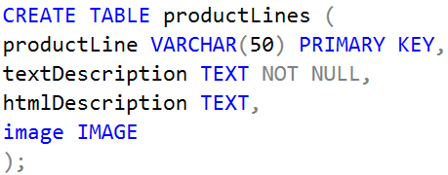
Design for OLTP Database: ProductLines
Purpose of this table
The purpose of this table is to contain the information of the existing product lines.
Explanation of table fields
productLine is the primary key that identifies the rows of the different product lines.

Slide 15
OLTP
Online Transactional Processing Database
Process

Slide 16
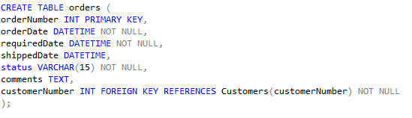
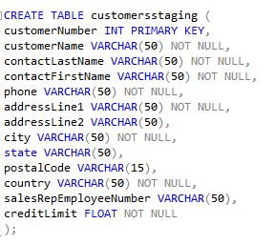
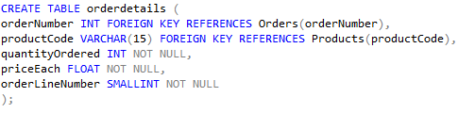
Process for OLTP Database (Table Creation)

Slide 17
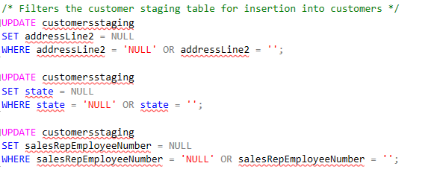
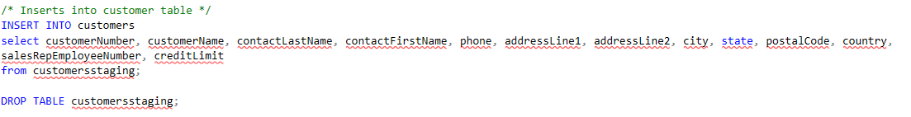
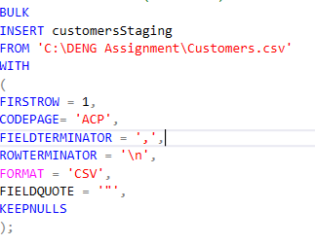
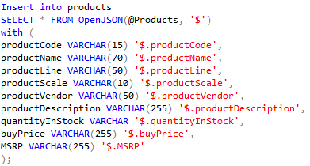
Process for OLTP Database (Table Insert)

Slide 18
OLAP
Online Analytical Processing Database
Design

Slide 19
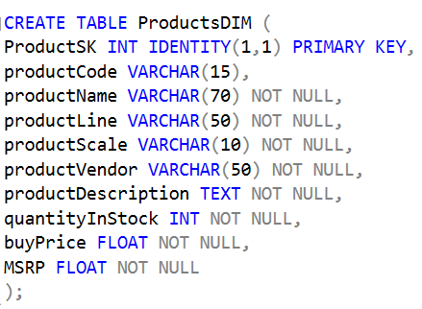
Design for OLAP Database (ProductsDIM)
Purpose of this table
Houses product information that has gone through the ETL process from the OLTP.
Explanation of table fields
ProductSK acts as the surrogate and primary key instead of productCode, where it uniquely identifies each row information and increments by 1 for every new row inserted.
All the other columns are the same as the OLTP.

Slide 20
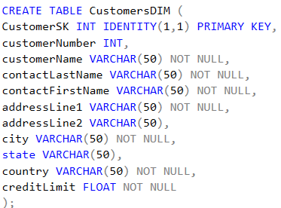
Design for OLAP Database (CustomersDIM)
Purpose of this table
Contain customer’s information.
Explanation of table fields
CustomerSK has the same reasoning. It uniquely identifies each customer. Everything else matches the OLTP except that phone, postal code are now removed as they are redundant data for analytical purposes.

Slide 21
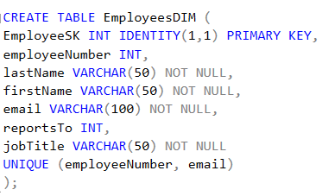
Design for OLAP Database (EmployeesDIM)
Purpose of this table
The EmployeesDIM contains the information of employees.
Explanation of table fields
EmployeeSK has the same reasoning.
Everything else is the same for the OLTP except officeCode, where it was moved to the SalesFacts.

Slide 22
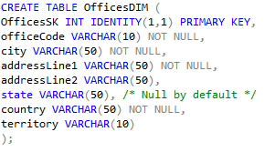
Design for OLAP Database (OfficesDIM)
Purpose of this table
The purpose of this dimensional table is to provide structured information of the different offices for analytical purposes.
Explanation of table fields
OfficesSK is also has the same reasoning.
Everything else is the same as the OLTP except for phone and postalCode.

Slide 23
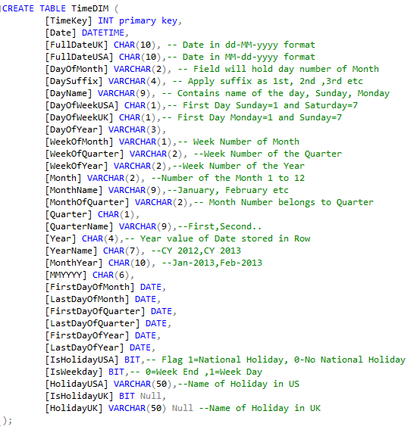
Design for OLAP Database (TimeDIM)
Purpose of this table
Contains information of all dates from 2003-2005.
Efficient data analysis
Time standardisation

Slide 24
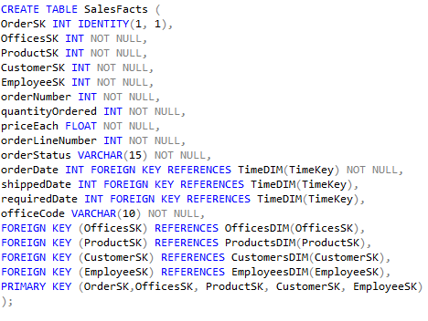
Design for OLAP Database (SalesFacts)
Purpose of this table
The purpose of the fact table is to contain all information of the orders made by existing Customers and the information is focused on a business process such as Sales.
Explanation of table fields
5 unique Surrogate Keys

Slide 25
OLAP
Online Analytical Processing Database
Process

Slide 26
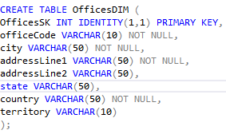
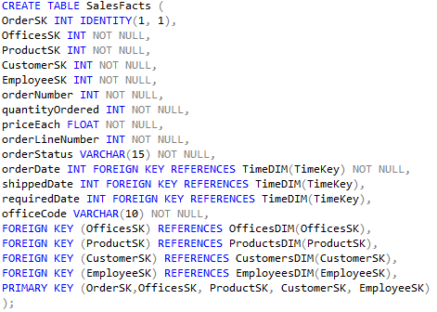
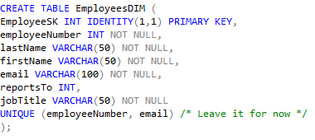
Process for OLAP Database(Table Creation)

Slide 27
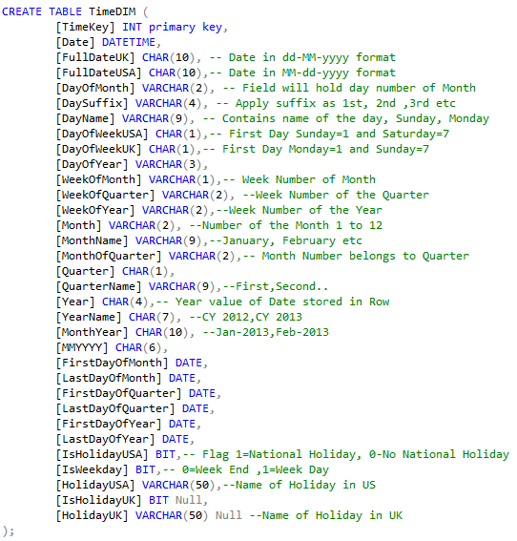
Process for OLAP Database(Time Dimension)

Slide 28
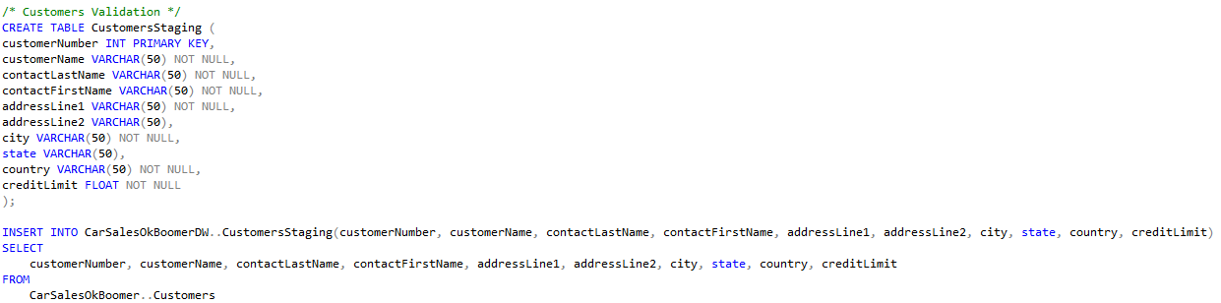
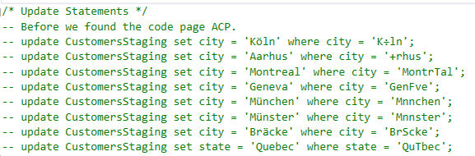
Process for OLAP Database(ETL Process)
Inconsistencies in the naming Conventions of the Cities & States (Special Characters not recognised)
Resolved a number of inconsistencies using ‘CODE PAGE’ argument for the Bulk Insert

Slide 29
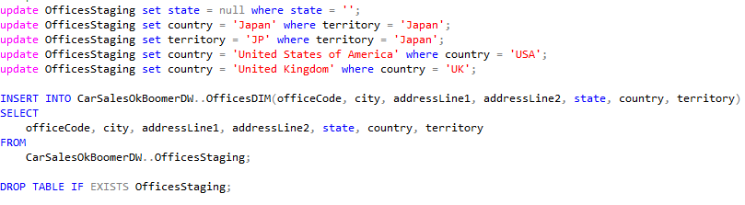

Process for OLAP Database(ETL Process)
Staging Tables used to cleanse & standardise Data, mix of Multistage Data transformation and inhouse Data transformation
Countries and Territories were not standardised. This helps in querying results & improves accuracy.
Once data has been cleansed & standardised, we transfer it into the DW table that will be used for the Analytical queries

Slide 30
Process for OLAP Database(Data Accuracy)
As dealing with data transfers and cleansing from a flat file to the OLTP then to the OLAP, there is bound to be Data Accuracy errors.
We encountered a issue where we had 12000+ rows for our SalesFacts whereas the Order Details only had 2996 rows. We resolved this by remvoing one of the JOIN statements. (Caused by no link between tables)
So to check for Data Accuracy we did the following;
Anonymous row checks against source data (flat file)
Anonymous row checks against the source DB (OLTP)
Aggregate function(s) to check for Accuracy between OLTP and OLAP

Slide 31
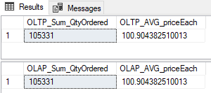
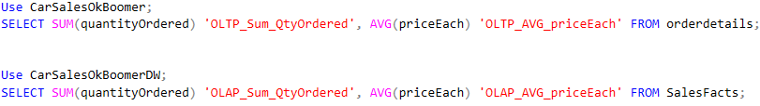
Process for OLAP Database(Data Accuracy)
Anonymous total rows imported against source data (flat file)
Customers table in OLTP has 122 rows, the source flat file also has 122 rows.
Anonymous row checks against the source DB (OLTP)
Aggregate function(s) to check for Accuracy between OLTP and OLAP

Slide 32
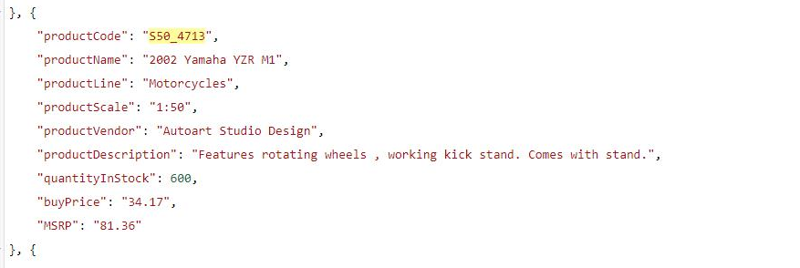
Process for OLAP Database(Data Accuracy)
The data accuracy actually helped us to identify an error…
During importation of the JSON data, we did not specify the varchar length so it took the first character of the ‘quantityInStock’ column. This caused the ‘600 quantity in stock’ or ‘1645’ quantity in stock, to be listed as ‘6’ and ‘1’ respectively.

Slide 33
Thank You!
Q & A

